Slide 1

Superstore Sales Analysis
Created by
Luthfi Adnan Rahmantyo
Luthfi.adnan@gmail.com
Linkedin
“Luthfi is a Data enthusiast and looking for opportunities in quantive analysis, data analysis, and data science with experience in data science bootcamp and certification in data science & machine learning. Luthfi is a fresh graduate from Telkom University in telecommunications engineering. He started learning about data science in February 2022 from Rakamin Academy and learning about machine learning from Bangkit Academy.
Luthfi has experienced working on Data Analysis, and Machine Learning Modelling”

Slide 2
Problem Statement
The Superstore dataset provides sales and profit data for a variety of products across different categories and regions.
The goal of this project is to analyze the data and identify insights that can help the company improve its business performance.
Specifically, we aim to answer questions such as: which product categories are the most profitable? Which regions have the highest sales and profit? What are the most profitable products?
By answering these questions, we hope to provide recommendations for the company on how to optimize its product offerings and improve its revenue and profitability.

Slide 3
Gather and Clean the Data
Once you have defined the problem or question, you need to gather the data you'll need to analyze.
This could involve collecting data from various sources or accessing existing data sets. You'll also need to clean the data to ensure it's accurate, complete, and consistent.

Slide 4
Explore the Data
Once you have your data, you'll need to explore it to get a sense of what it contains.
This might involve creating visualizations, calculating basic statistics, or conducting other exploratory analysis techniques.

Slide 5
Assumptions
The superstore dataset contains a representative sample of all transactions conducted by the store during the time period covered by the dataset.
The data in the superstore dataset is accurate and has been cleaned and preprocessed prior to analysis.
The superstore dataset covers a sufficient time period to allow for the identification of trends or patterns in sales and profitability.
The Super Store dataset is not impacted by any significant outliers or anomalies that could skew the results of any analysis conducted on the dataset.

Slide 6
Research questions
We’re interested in understanding which factors contribute to high sales in the superstore.
Which product categories have the highest profit margins in the Super Store?
Are there any significant differences in sales between the East region and other regions?
How do sales vary by product category during different months of the year?
What is the rate of returned products for orders with same-day shipping compared to other shipping options?
How do sales and profit vary by product category on weekdays compared to weekends?

Slide 7
Formulate Hypothesis
Hypothesis 1: Technology products have the highest profit margin compared to other product categories.
Hypothesis 2: The East region has the highest sales compared to other regions.
Hypothesis 3: Sales are higher during certain months of the year.
Hypothesis 4: Orders with same-day shipping have the lowest rate of returned products.
Hypothesis 5: The company's profit is more on weekdays than on weekends.

Slide 8
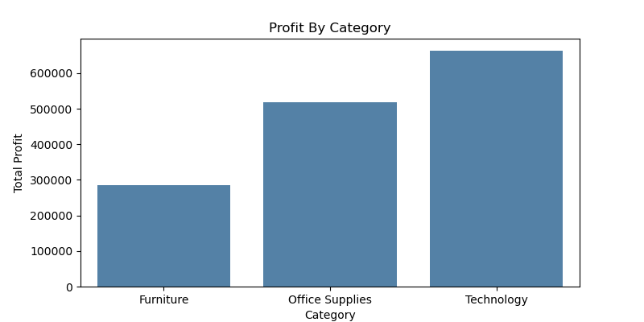
Test the Hypothesis
Hypothesis 1: Technology products have the highest profit margin compared to other product categories.
The Hypothesis is supported as technology products have the highest profit margin of the three categories.

Slide 9
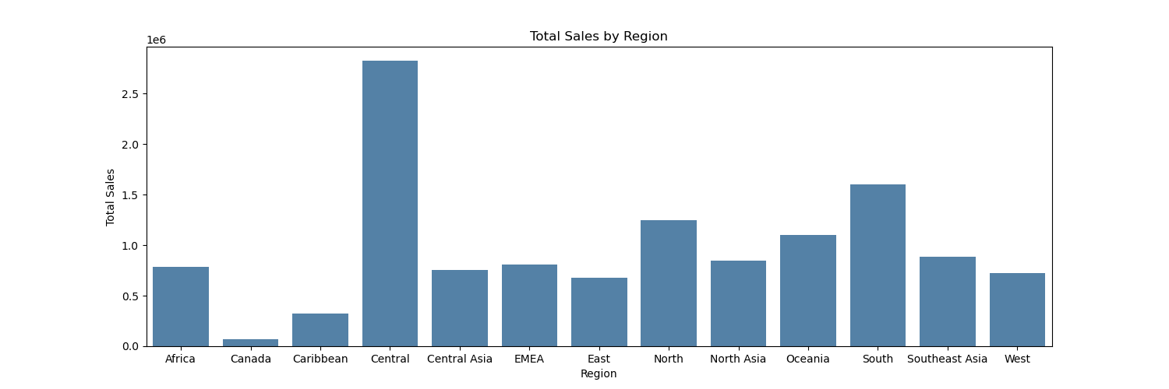
Test the hypothesis
Hypothesis 2: The East region has the highest sales compared to other regions.
The hypothesis is not supported as the Central region has the highest sales

Slide 10
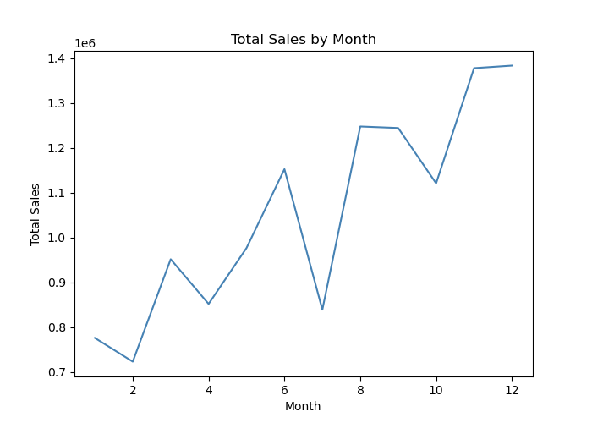
Test the hypothesis
Hypothesis 3: Sales are higher during certain months of the year.
Sales are higher in November and December.
This supports our hypothesis that sales are higher during certain months of the year.

Slide 11
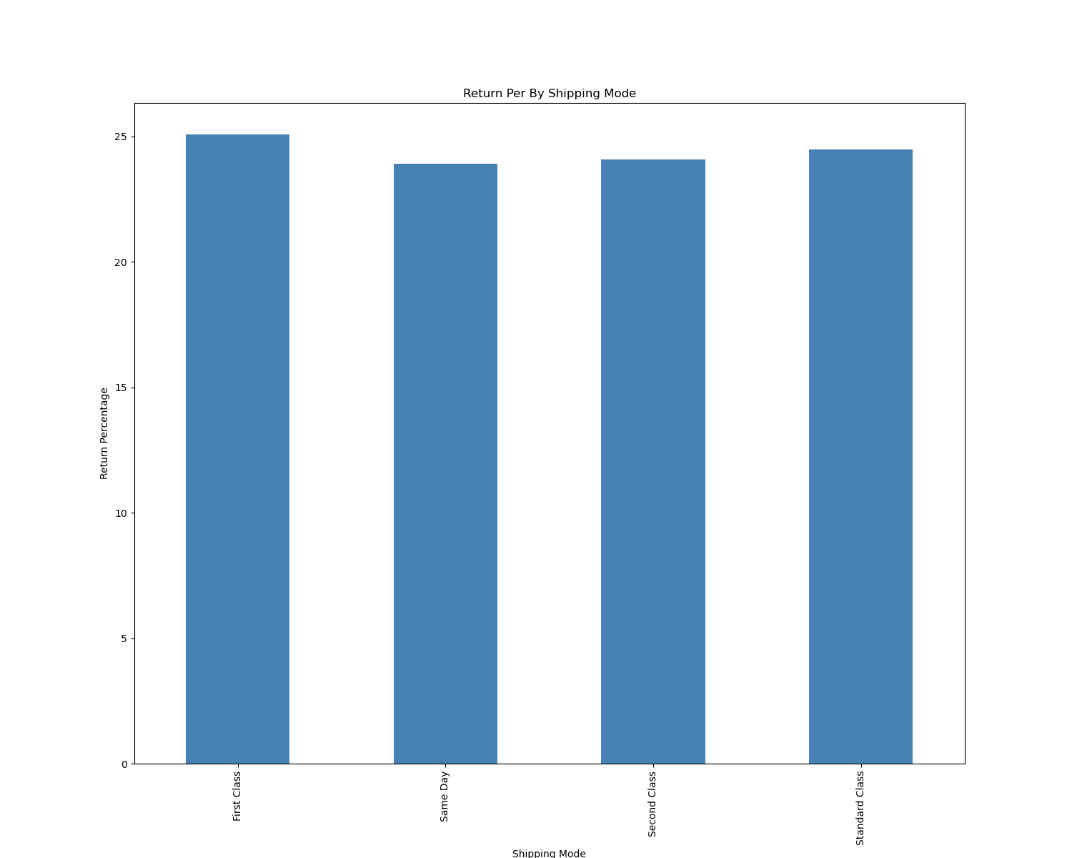
Test the hypothesis
Hypothesis 4: Orders with same-day shipping have the lowest rate of returned products.
The hypothesis is supported as orders with same-day shipping have the lowest rate of returned products.

Slide 12
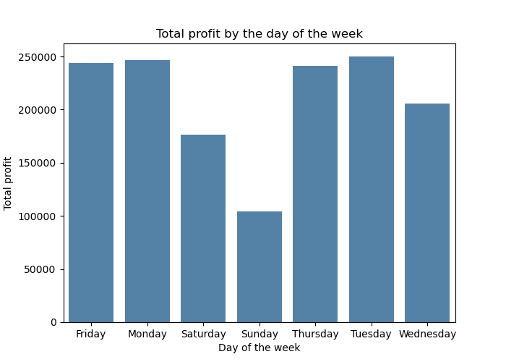
Test the hypothesis
Hypothesis 5: The Company's profit is more on weekdays than on weekends.
The hypothesis is supported as the company's profit is higher on weekdays compared to weekends.

Slide 13
Draw Conclusions
Hypothesis 1: Technology products have the highest profit margin compared to other product categories. This hypothesis is supported. The data shows that technology products have the highest profit margin compared to other product categories.
Hypothesis 2: The East region has the highest sales compared to other regions. This hypothesis is not supported. The data shows that the East region does not have the highest sales compared to other regions.
Hypothesis 3: Sales are higher during certain months of the year. This hypothesis is supported. The data shows that sales are higher during certain months of the year.
Hypothesis 4: Orders with same-day shipping have the lowest rate of returned products. This hypothesis is supported. The data shows that orders with same-day shipping have the lowest rate of returned products.
Hypothesis 5: The Company's profit is more on weekdays than on weekends. This hypothesis is supported. The data shows that the company's profit is more on weekdays than on weekends.

Slide 14
Communicate the result
Based on the analysis, it can be concluded that technology products have the highest profit margin compared to other product categories.
The company's profit is higher on weekdays than on weekends. Sales are higher during certain months of the year.
Orders with same-day shipping have the lowest rate of returned products. However, the hypothesis that the East region has the highest sales compared to other regions is not supported by the data.
These conclusions provide valuable insights into the company's performance and can guide future decision-making processes.
It is important to note that further investigation may be required to fully understand the underlying factors influencing these observations.

Slide 15
Suggestions
The company should focus on developing and promoting technology products to increase its profits. They could also consider reducing the production and promotion of products with lower profit margins.
Central region has the highest sales compared to other regions; the company could consider increasing its focus on this region. then the company should re-evaluate its marketing and sales strategies in other regions.
The company should focus on maximizing sales during the months of November and December. This could involve increasing the inventory of popular products during this time, running targeted marketing campaigns, and offering promotions or discounts to customers. However, the company should also consider strategies to maintain sales during other months, such as introducing new products or services or offering promotions and discounts during slower months.

Slide 16
Suggestions
The company could consider offering more same-day shipping options to customers. This might involve optimizing inventory and supply chain processes to ensure that products can be shipped quickly and efficiently.
The company could consider focusing on different types of promotions or sales during the weekends to increase sales. For example, the company could offer weekend-only promotions or discounts or run targeted marketing campaigns aimed at weekend shoppers. The company could also consider offering special events or activities in-store on weekends to attract customers and increase sales. Additionally, the company could focus on offering products and services that are particularly popular among weekend shoppers, such as home entertainment or outdoor products.

